Slide 1
Bank loan management system

Slide 2
Introduction
Project Title: Bank Loan Management System
Course: programming in c
Presented By: – Kaisar Malik
Faculty: Dr. Prashant Trivedi

Slide 3
Overview
Scope of the Project:
Loan application
EMI calculation
EMI schedule generation
Installment payment tracking
Payment history display

Slide 4
1. Problem Definition
What Problem Does This Project Solve?
Manual loan processing is slow and error‑prone.
Tracking EMI payments manually is difficult.
Customers need a transparent system to view loan status.
Why Is It Important?
Banks handle thousands of loans every day.
Automation reduces human error and improves accuracy.
Helps customers understand EMI, interest, and payment history.

Slide 5
2. Solution Approach
Methodology
Implemented using C programming
Uses file handling to store loan details and payment history
EMI calculated using mathematical formula
Menu‑driven interface for easy navigation
System Architecture
Input Module: User details, salary, credit score
Processing Module: Eligibility check, EMI calculation
Storage Module: loan.txt, payments.txt
Output Module: EMI schedule, payment history

Slide 6
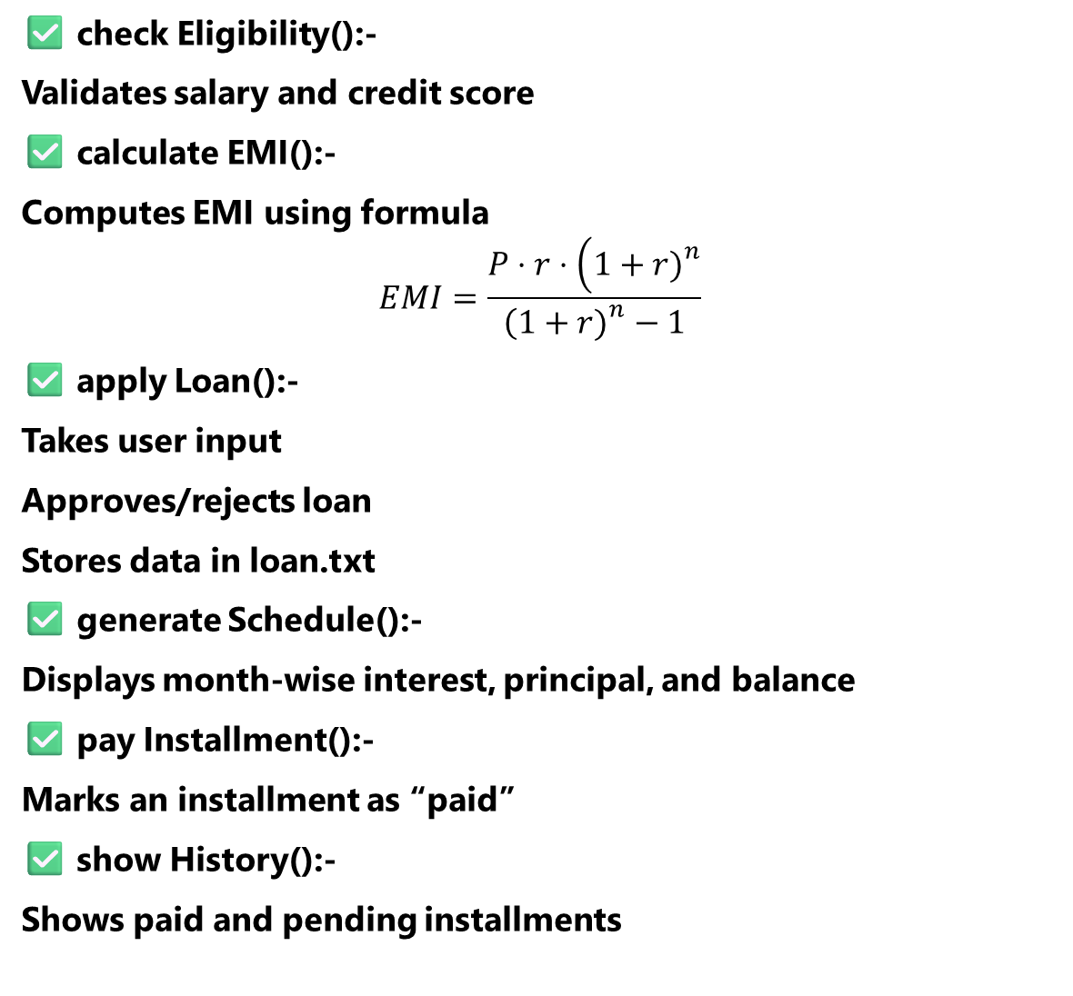
✅ check Eligibility():-
Validates salary and credit score
✅ calculate EMI():-
Computes EMI using formula
$$EMI=\frac{P⋅r⋅\left(1+r{\left.)\right.}^{n}\right.}{\left(1+r{\left.)\right.}^{n}−1\right.}$$
✅ apply Loan():-
Takes user input
Approves/rejects loan
Stores data in loan.txt
✅ generate Schedule():-
Displays month‑wise interest, principal, and balance
✅ pay Installment():-
Marks an installment as “paid”
✅ show History():-
Shows paid and pending installments

Slide 7
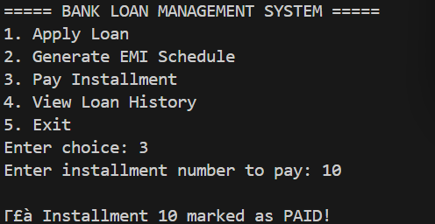

Slide 8
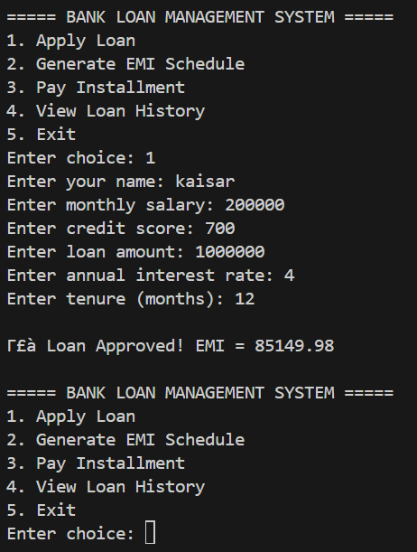
3. Working Code Demonstration
Live Demo Requirements
Show file structure
Show code execution
Demonstrate each menu option
creens to Show
Loan Application
EMI Schedule
Installment Payment
Payment History

Slide 9
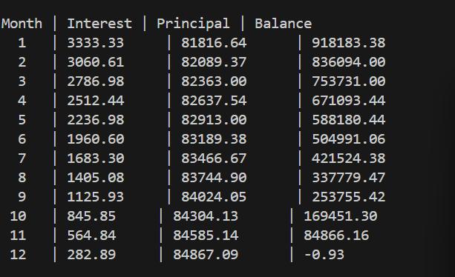
EMI Schedule Output
Displays month‑wise breakdown
Shows interest, principal, and remaining balance
Helps user understand repayment structure

Slide 10
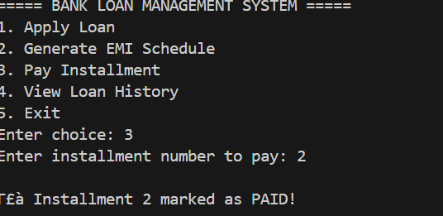
Installment Payment Tracking:-
-User selects installment number
-System marks it as paid

Slide 11
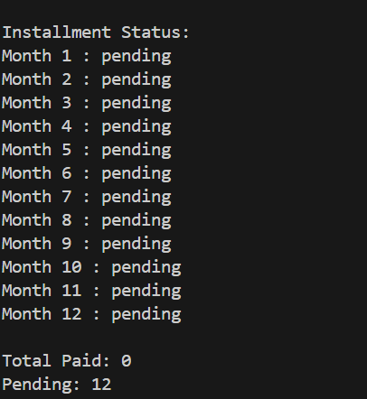
Loan History:-
-Shows all installments
-Displays paid and pending
-Summary: total paid vs pending

Slide 12
Questions & answers
.

Slide 13
Resources
C Programming Textbooks
Online C documentation
Tutorials on file handling
EMI calculation formula resources
Classroom notes and faculty guidance
List the resources you used for your research:
C Programming Textbooks
Online C documentation
Tutorial on file handling
EMI calculation formula ressources
Classroom notes and faculty guidance
C Programming Textbooks
Online C documentation
Tutorials on file handling
EMI calculation formula resources
Classroom notes and faculty guidance

